Slide 1
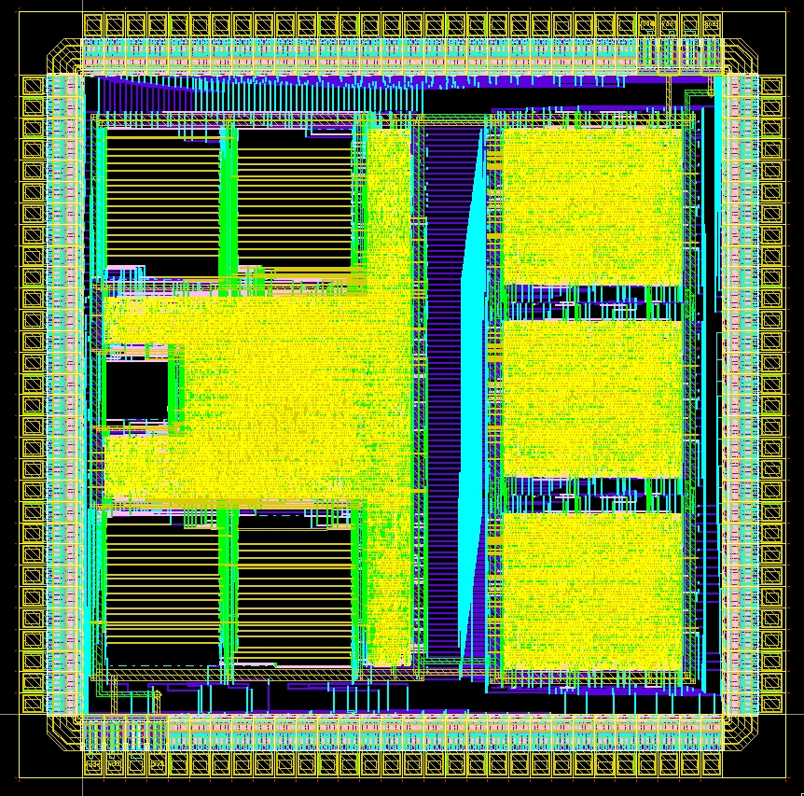
Digital Systems and Microprocessor Design (H7068)
8.2. Inside UoS Educational Processor
Daniel Roggen
d.roggen@sussex.ac.uk

Slide 2
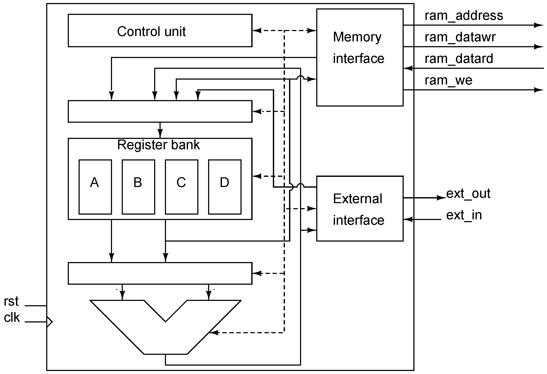
Architecture

Slide 3
VHDL files
cpu.vhd: top file for CPU
cpusequencer.vhd: fetch/execute sequence
cpuregbank.vhd: register file
cpualu.vhd : ALU

Slide 4
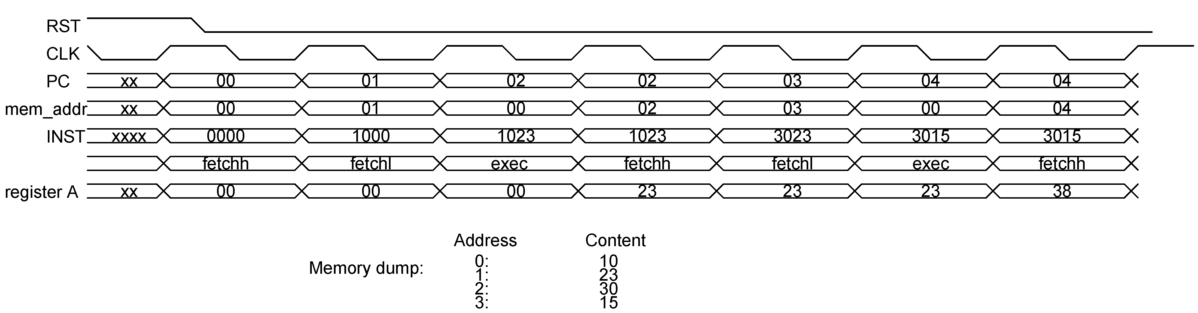
Fetch/Execute sequence
3 clock cycles per instruction
  Fetch high
  Fetch low
  Execute...
Circuit must organize this sequence

Slide 5
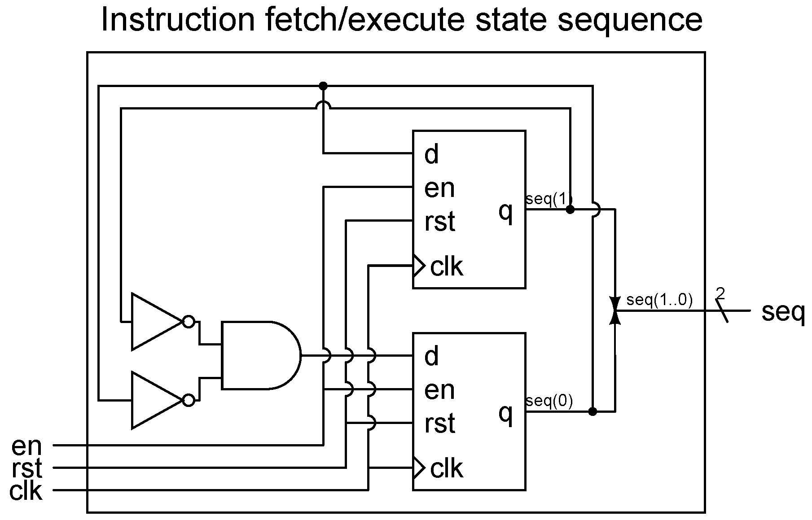
Fetch/Execute sequence
In cpusequencer.vhd
Up counter until 2 (10b): 00=fetchh, 01=fetchl, 10=exec

Slide 6
Fetch/Execute sequence
entity cpusequencer is
port(
clk : in STD_LOGIC;
rst : in STD_LOGIC;
en : in STD_LOGIC;
seq : out STD_LOGIC_VECTOR(1 downto 0)
);
end cpusequencer;
clk: clock
rst: reset
en: enable (currently not used: always wired to 1)
seq: 2-bit code for fetchh, fetchl, exec

Slide 7
Fetch/Execute sequence
clock in sensitivity list
process(clk)
begin
if rising_edge(clk) then
if rst='1' then
s<="00";
else
if en='1' then
if s="10" then
s <= "00";
else
s <= s+1;
end if;
end if;
end if;
end if;
end process;
seq <= s;
All happens on rising clock edge
Reset
Normal behavior: if enabled, increment and wrap around at 2
VHDL does additions with '+'!
Not taught in this module.
Synthesizer chooses an implementation on its own
Choice not critical here with 2 bits; with more bits specific adder architectures may be preferred

Slide 8
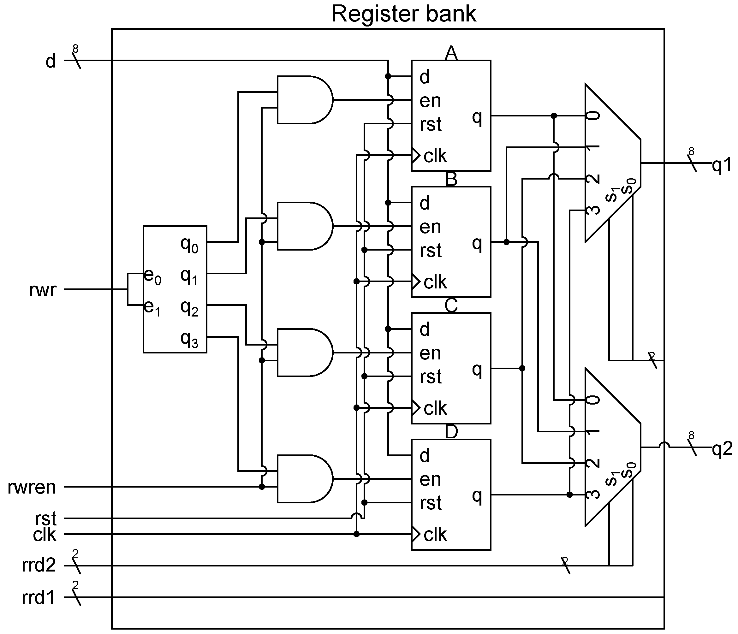
Register file (register bank)
All D FF with enable and reset (synchronous)
registers A-D

Slide 9
Register file (register bank)
Reminder: move instruction
Always operation between dst and src, with result in dst
Let's consider what to read from our register bank:
  The register defined by dst and src (even if we deal with an immediate-this is handled elsewhere
Instructions | instruction(15..8) |  |  |  |  |  |  |  | Instruction(7..0)
Move | Opcode |  |  |  | dd#m | sd#m | dreg |  | src
mov r, r | 0 | 0 | 0 | 0 | 0 | 0 | r | r | - | - | - | - | - | - | r | r
mov r, i | 0 | 0 | 0 | 1 | 0 | 0 | r | r | i | i | i | i | i | i | i | i
mov r, [r] | 0 | 0 | 0 | 0 | 0 | 1 | r | r | - | - | - | - | - | - | r | r
mov r, [i] | 0 | 0 | 0 | 1 | 0 | 1 | r | r | i | i | i | i | i | i | i | i
mov [r], r | 0 | 0 | 0 | 0 | 1 | 0 | r | r | - | - | - | - | - | - | r | r
mov [r], i | 0 | 0 | 0 | 1 | 1 | 0 | r | r | i | i | i | i | i | i | i | i

Slide 10
Register file (register bank)
register to read from
(the 2 bits come from src or dst in the instruction!)
entity cpuregbank is
port(
clk : in STD_LOGIC;
rrd1 : in STD_LOGIC_VECTOR(1 downto 0);
rrd2 : in STD_LOGIC_VECTOR(1 downto 0);
rwr : in STD_LOGIC_VECTOR(1 downto 0);
rwren : in STD_LOGIC;
rst : in STD_LOGIC;
d : in STD_LOGIC_VECTOR(7 downto 0);
q1 : out STD_LOGIC_VECTOR(7 downto 0);
q2 : out STD_LOGIC_VECTOR(7 downto 0);
-- Only for debugging
dbg_qa : out STD_LOGIC_VECTOR(7 downto 0);
dbg_qb : out STD_LOGIC_VECTOR(7 downto 0);
dbg_qc : out STD_LOGIC_VECTOR(7 downto 0);
dbg_qd : out STD_LOGIC_VECTOR(7 downto 0)
);
end cpuregbank;
register to write to (always dst)
rwren: enable write
d: data to write
outputs of the register bank
This would not be here in a "production" processor: here to display the content of the register on the 7 segment display

Slide 11
Register file (register bank)
architecture Behavioral of cpuregbank is
signal enables: STD_LOGIC_VECTOR(3 downto 0);
signal qa,qb,qc,qd: STD_LOGIC_VECTOR(7 downto 0);
begin
ra: entity work.dffre generic map (N=>8) port map(clk=>clk,en=>enables(0),rst=>rst,d=>d,q=>qa);
rb: entity work.dffre generic map (N=>8) port map(clk=>clk,en=>enables(1),rst=>rst,d=>d,q=>qb);
rc: entity work.dffre generic map (N=>8) port map(clk=>clk,en=>enables(2),rst=>rst,d=>d,q=>qc);
rd: entity work.dffre generic map (N=>8) port map(clk=>clk,en=>enables(3),rst=>rst,d=>d,q=>qd);
enable each register
q: output of each register
Instantiate a register with reset and enable.
Generic map: parameterized register.

Slide 12
Register file (register bank)
2-4 decoder: when write is enabled one of the register is enabled for write
with rwr select
enables <="0001" and rwren&rwren&rwren&rwren when "00",
"0010" and rwren&rwren&rwren&rwren when "01",
"0100" and rwren&rwren&rwren&rwren when "10",
"1000" and rwren&rwren&rwren&rwren when others;
with rrd1 select
q1 <= qa when "00",
qb when "01",
qc when "10",
qd when others;
with rrd2 select
q2 <= qa when "00",
qb when "01",
qc when "10",
qd when others;
first output multiplexer
second output multiplexer

Slide 13
Register
entity dffre is
generic (N : integer);
port(
clk : in STD_LOGIC;
en : in STD_LOGIC;
rst: in STD_LOGIC;
d : in STD_LOGIC_VECTOR(N-1 downto 0);
q : out STD_LOGIC_VECTOR(N-1 downto 0)
);
end dffre;
generic: useful to create components that can be parameterized
generic: useful to create components that can be parameterized
Here N is the number of bits of the D flip-flop

Slide 14
Register
architecture Behavioral of dffre is
begin
process(clk)
begin
if rising_edge(clk) then
if rst='1' then
q<=(others=>'0');
else
if en='1' then
q<=d;
end if;
end if;
end if;
end process;
all on rising edge
synchronous reset
copy if enabled

Slide 15
VHDL generic
In the component declaration:
entity entity_name is
generic (generic list);
port (port list);
end entity_name;
In the component instantiation:
label: entity work.comp_name
generic map (generic_association_list)
port map (port_association_list);

Slide 16
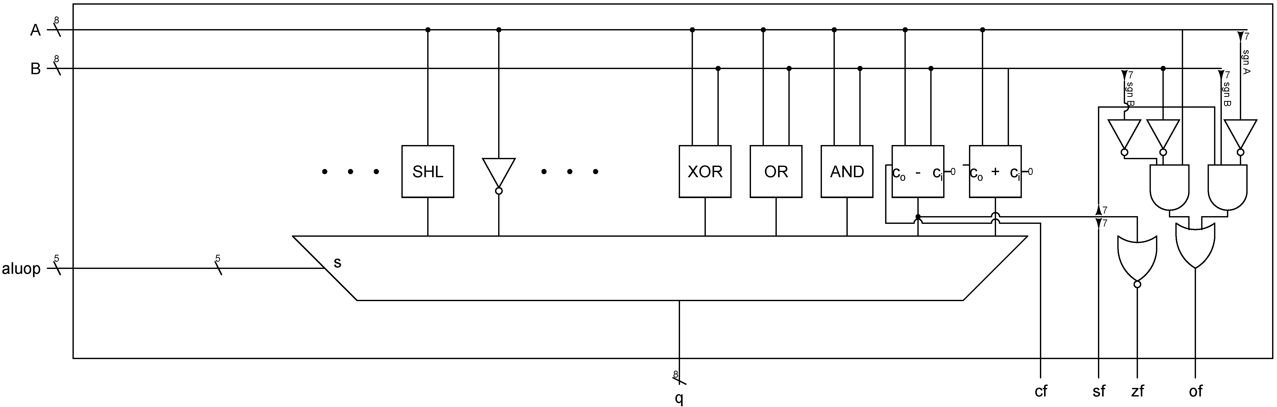
ALU
A, B: input of the ALU (8 bits)
aluop: operation to perform (5 bits)
  bit 14 to bit 10 of instruction to identify the type of operation
  (part opcode and part other bits of the instruction)
Implemented as multiplexer
flags as discrete logic

Slide 17

ALU
Instructions | instruction(15..8) |  |  |  |  |  |  |  | Instruction(7..0)
ALU 2 op | opcode |  |  |  | ALU op |  | dreg |  | src
add r, r | 0 | 0 | 1 | 0 | 0 | 0 | r | r | - | - | - | - | - | - | r | r
add r, i | 0 | 0 | 1 | 1 | 0 | 0 | r | r | i | i | i | i | i | i | i | i
xor r, r | 0 | 1 | 0 | 0 | 0 | 0 | r | r | - | - | - | - | - | - | r | r
Test | opcode |  |  |  | ALU op |  | dreg |  | immedite / reg
cmp r, r | 0 | 1 | 0 | 0 | 0 | 1 | r | r | - | - | - | - | - | - | r | r
cmp r, i | 0 | 1 | 0 | 1 | 0 | 1 | r | r | i | i | i | i | i | i | i | i
Instructions | instruction(15..8) |  |  |  |  |  |  |  | Instruction(7..0)
ALU 1 op | opcode |  |  | ALU op |  |  | dreg
not r | 0 | 1 | 1 | 0 | 0 | 0 | r | r | - | - | - | - | - | - | - | -
shr r | 0 | 1 | 1 | 0 | 0 | 1 | r | r | - | - | - | - | - | - | - | -
...
Only the bits in red are necessary to define the ALU operation!

Slide 18
ALU
entity cpualu is
port (
clk : in STD_LOGIC;
rst : in STD_LOGIC;
op : in STD_LOGIC_VECTOR(4 downto 0);
a : in STD_LOGIC_VECTOR(7 downto 0);
b : in STD_LOGIC_VECTOR(7 downto 0);
q : out STD_LOGIC_VECTOR(7 downto 0);
f : out STD_LOGIC_VECTOR(3 downto 0)
);
end cpualu;
Input A,B
Output
Flags
Flags are always returned, but only used if the instruction is "cmp": control unit stores the flag in a flag register

Slide 19
ALU
r <= a+b when op(4 downto 3)="01" and op(1 downto 0)="00" else
sub(7 downto 0) when op(4 downto 3)="01" and op(1 downto 0)="01" else
a and b when op(4 downto 3)="01" and op(1 downto 0)="10" else
a or b when op(4 downto 3)="01" and op(1 downto 0)="11" else
a xor b when op(4 downto 3)="10" and op(1 downto 0)="00" else
not a when op(4 downto 0)="11000" else
'0'&a(7 downto 1) when op(4 downto 0)="11001" else
a(0)&a(7 downto 1) when op(4 downto 0)="11010" else
a(7)&a(7 downto 1) when op(4 downto 0)="11011" else
a(6 downto 0)&a(7) when op(4 downto 0)="11100" else
"00000000";
Multiplexer
Can you recognize an instruction?
Add is 001000rr ------rr
or 001100rr iiiiiiii
(in red op)
Therefore we react is op(4..3)=01 and op(1..0)=00

Slide 20
ALU
sf <= sub(7);
zf <= not(sub(7) or sub(6) or sub(5) or sub(4) or sub(3) or sub(2) or sub(1) or sub(0));
cf <= sub(8);
ovf <= (not a(7) and b(7) and sub(7)) or (a(7) and not b(7) and not sub(7));
f<=zf&ovf&cf&sf;
q<=r;
Combine flags in a vector
Sign flag is bit 7 of the subtraction
Zero flag obtained by oring
Carry flag is bit 8 of the subtration (only 8 bits are returned but subtraction done on 9 bits to obtain the carry)
Overflow flag: triggers when the result flips sign:
  positive minus negative must give positive
  negative minus positive must give negative
  Otherwise it's an overflow

Slide 21
Top level CPU entity
entity cpu is
generic(N : integer);
port(
clk : in STD_LOGIC;
rst : in STD_LOGIC;
ext_in : in STD_LOGIC_VECTOR(7 downto 0);
ext_out : out STD_LOGIC_VECTOR(7 downto 0);
ram_we : out STD_LOGIC;
ram_address : out STD_LOGIC_VECTOR(N-1 downto 0);
ram_datawr : out STD_LOGIC_VECTOR(7 downto 0);
ram_datard : in STD_LOGIC_VECTOR(7 downto 0);
-- Only for debugging
dbg_qa : out STD_LOGIC_VECTOR(7 downto 0);
dbg_qb : out STD_LOGIC_VECTOR(7 downto 0);
dbg_qc : out STD_LOGIC_VECTOR(7 downto 0);
dbg_qd : out STD_LOGIC_VECTOR(7 downto 0);
dbg_instr : out STD_LOGIC_VECTOR(15 downto 0);
dbg_seq : out STD_LOGIC_VECTOR(1 downto 0);
dbg_flags : out STD_LOGIC_VECTOR(3 downto 0)
);
end cpu;
External interface
Memory interface

Slide 22
CPU: instantiating the register bank
comp_regs: entity work.cpuregbank port map(
clk=>clk,rst=>rst,
rrd1=>instruction(9 downto 8),
rrd2=>instruction(1 downto 0),
rwr=>instruction(9 downto 8),
rwren=>regwren,
d=>wrdata,
q1=>reg1out,q2=>reg2out);
The instruction set is designed to help the control unit
Source and destination always in the same location in the instruction
  reg1out is the value in the "dst" register
  reg2out is the value in the "src" register
It does not hurt to "wire up" src and dst to the register bank, even if the instruction does not use src/dst (the control unit handles that)
Write only occurs with a Move or an ALU instruction!
1st register is "dst"
2nd register is "src"
write register is "dst "
Controls the write
1st and 2nd register output

Slide 23
CPU: instantiating fetch/execute
comp_seq: entity work.cpusequencer port map(clk=>clk,rst=>rst,en=>'1',seq=>seq);
fetchh <= '1' when seq="00" else
'0';
fetchl <= '1' when seq="01" else
'0';
execute <= '1' when seq="10" else
'0';
fetch <= fetchl or fetchh;
Helper signals - not mandatory but makes reading simpler

Slide 24
CPU: fetch instruction
comp_instrh: entity work.dffre generic map(N=>8)
port map(clk=>clk,rst=>rst,en=>fetchh,d=>ram_datard, q=>instruction(15 downto 8));
comp_instrl: entity work.dffre generic map(N=>8) port map(clk=>clk,rst=>rst,en=>fetchl,d=>ram_datard, q=>instruction(7 downto 0));
instruction is the 16-bit instruction read from memory
It is 16-bit register realized by two 8-bit D flip-flops
First flip-flop enabled on "fetch high"
Second flip-flop enabled on "fetch low"

Slide 25
CPU: Program counter / instruction pointer
comp_ip: entity work.dffre generic map(N=>N) port map(clk=>clk,rst=>rst,en=>'1',d=>ipnext,q=>ip);
ipnext <= ip+1 when fetch='1' else
ip when jump='0' else
jumpip;
ip is the address where the instruction is read from
N-bit D flip-flop
  In the laboratory N is 5 bits (0...1F). It's a Design choice
ipnext is the input of the D flip-flop

Slide 26
CPU: Program counter / instruction pointer
comp_ip: entity work.dffre generic map(N=>N) port map(clk=>clk,rst=>rst,en=>'1',d=>ipnext,q=>ip);
ipnext <= ip+1 when fetch='1' else
ip when jump='0' else
jumpip;
When to write: at each clock cycle!
What to write:
  Fetch (high or low): ipnext = ip+1
  Exec:
    ipnext does not change if the instruction is not a jump
    ipnext changes if it is an absolute jump, or a conditional jump with the condition valid
      (indicated by the signal jump)

Slide 27
CPU: Jump
Instructions | instruction(15..8) |  |  |  |  |  |  |  | Instruction(7..0)
Jump Unsigned: JA, JAE, JB, JBE | opcode |  |  |  | Jump type |  |  |  | immedite / reg
jmp r | 1 | 0 | 1 | 0 | 0 | 0 | 0 | 0 | - | - | - | - | - | - | r | r
jmp i | 1 | 0 | 1 | 1 | 0 | 0 | 0 | 0 | i | i | i | i | i | i | i | i
je/jz r | 1 | 0 | 1 | 0 | 0 | 0 | 0 | 1 | - | - | - | - | - | - | r | r
je/jz i | 1 | 0 | 1 | 1 | 0 | 0 | 0 | 1 | i | i | i | i | i | i | i | i
jne/jnz r | 1 | 0 | 1 | 0 | 1 | 0 | 0 | 1 | - | - | - | - | - | - | r | r
jne/jnz i | 1 | 0 | 1 | 1 | 1 | 0 | 0 | 1 | i | i | i | i | i | i | i | i
ja r | 1 | 0 | 1 | 0 | 0 | 0 | 1 | 0 | - | - | - | - | - | - | r | r
ja i | 1 | 0 | 1 | 1 | 0 | 0 | 1 | 0 | i | i | i | i | i | i | i | i
jb r | 1 | 0 | 1 | 0 | 1 | 0 | 1 | 1 | - | - | - | - | - | - | r | r
jb i | 1 | 0 | 1 | 1 | 1 | 0 | 1 | 1 | i | i | i | i | i | i | i | i
Unconditional jumps for 101x000 only
Address is register or immediate: it is source defined before

Slide 28
CPU: Jump
Where to jump if we were to do it
jumpip <= source(N-1 downto 0);
jump <= '1' when instruction(15 downto 13) = "101" and jumpconditionvalid='1' else
'0';
jumpconditionvalid <=
'1' when instruction(11 downto 8) = "0000" else
-- je/jz
'1' when instruction(11 downto 8) = "0001" and zf='1' else
-- jne/jnz
'1' when instruction(11 downto 8) = "1001" and zf='0' else
-- ja
'1' when instruction(11 downto 8) = "0010" and zf='0' and cf='0' else
-- jb
'1' when instruction(11 downto 8) = "1011" and zf='0' and cf='1'
else '0';
jump if there is a jump instruction and the jump condition is valid
always valid (unconditional jump)
Conditional jump when not zero: check the zero flag

Slide 29
CPU: source (helper signal)
source <= reg2out when instruction(12)='0' else
instruction(7 downto 0);
Many instructions use a "source": Move, ALU, Jump, out
All these instructions use as source:
  an immediate in the lower 8 bits of the instruction if R#/I=1
  a register (output of the register bank) if R#/I=0
R#/I is always instruction(12)
source takes care of providing the right source (immediate or register) using a multiplexer
  Either the immediate
  or the 2nd output of register bank (src)

Slide 30
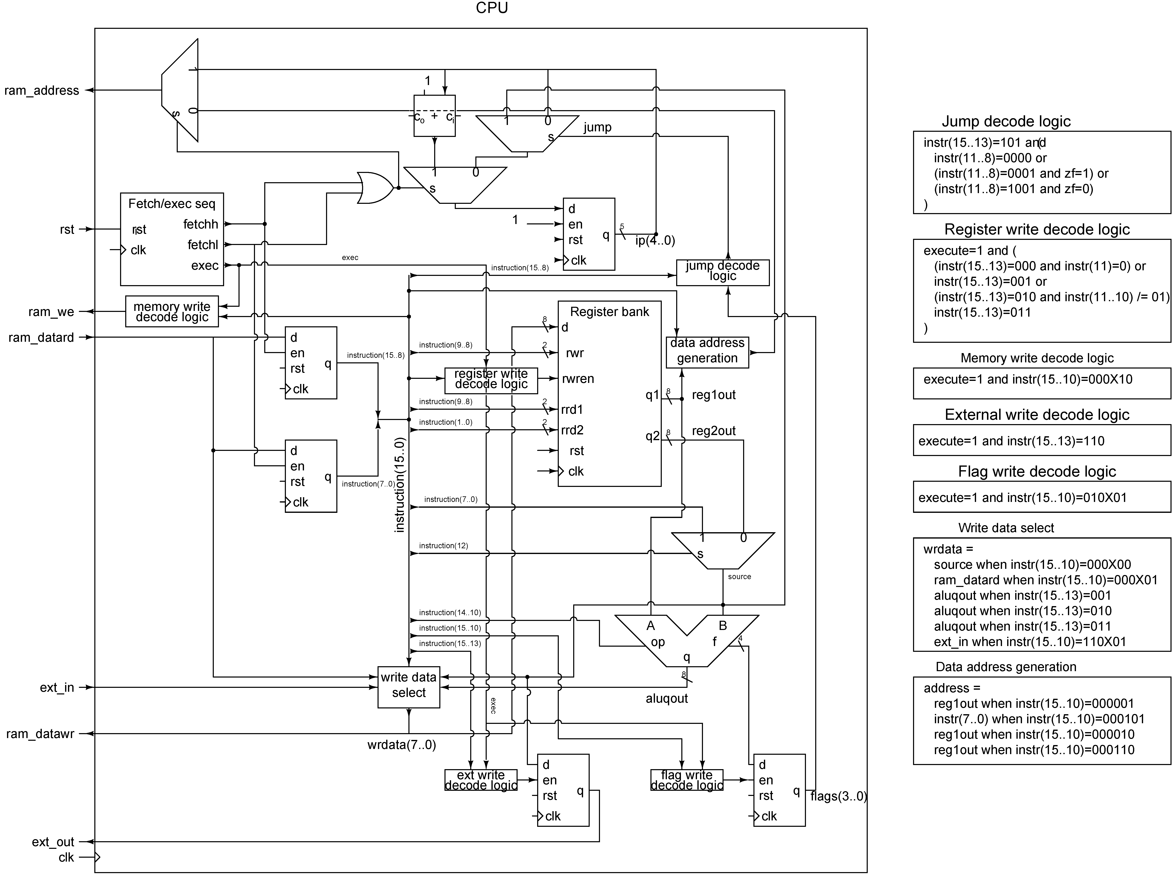
CPU: when to write to register
regwren: helper signal indicating when to write to register (register file)
Write to register only during execute cycle
And:
  The instruction is a Move
  Or the instruction is ALU (but not "cmp")
  Or the instruction is In

Slide 31
CPU: what to write
wrdata: helper signal containing the data to write:
  Data for memory and register write
  wrdata is connected to the register bank write input!
What to write:
  Move direct instruction: the data to write is "source" (either immediate or register)
  Move from memory instr.: write what the memory chip provides
  ALU instruction: write the output of the ALU
  In instruction: write what is on the input of the external interface

Slide 32
CPU: memory interface
What to write (put on the data bus)?
  wrdata always
What to put on the address bus?
When to write?

Slide 33
CPU: memory interface
ram_address <=
ip when fetch='1' else
reg2out(N-1 downto 0) when instruction(15 downto 10)="000001" else
instruction(N-1 downto 0) when instruction(15 downto 10)="000101" else
reg1out(N-1 downto 0) when instruction(15 downto 10)="000010" else
reg1out(N-1 downto 0) when instruction(15 downto 10)="000110" else
(others=>'0');
Address:
  IP during the fetch cycles
  The content of the src register or of the immediate for a move from memory
  the content of the dst register for a move to memory
  Otherwise zero
    Explains why the first CPU lab showed always a zero on the address!

Slide 34
CPU: when to write to memory?
Move to memory during the exec cycle:
  mov [b],23h
ram_we <=
'1' when execute='1' and instruction(15 downto 13)="000" and instruction(11 downto 10)="10"
else '0';

Slide 35
CPU: External interface
External interface output is an 8-bit D flip-flop
When to write: during exec when instruction is "out"
What to write: source (i.e. register or immediate)
comp_regextout :
entity work.dffre generic map (N=>8)
port map(clk=>clk,rst=>rst,en=>ext_wren, d=>source,q=>ext_out);
ext_wren <=
'1' when execute='1' and instruction(15 downto 13) = "110" and instruction(11 downto 10)="00"
else '0';

Slide 36
CPU: flags
SF, CF, OF, ZF are stored in a 4-bit D flip-flop
When to write: during exec and "cmp" instruction
What to write: the flag output of the ALU
comp_flags: entity work.dffre
generic map(N=>4)
port map(clk=>clk,rst=>rst,en=>flagwren,d=>alufout,q=>flags);
flagwren <= '1' when execute='1' and instruction(15 downto 13)="010" and instruction(11 downto 10)="01"
else '0';

Slide 39
Summary
Brief insight into the processor architecture
Basic understanding of the control unit function:
  deciding what and when to "store" data in register
Sufficient knowledge to perform the coursework assignment on:
  Modifying the instruction set (adding instruction)
  Tracing the state of key signals for a given instruction

